Slide 1
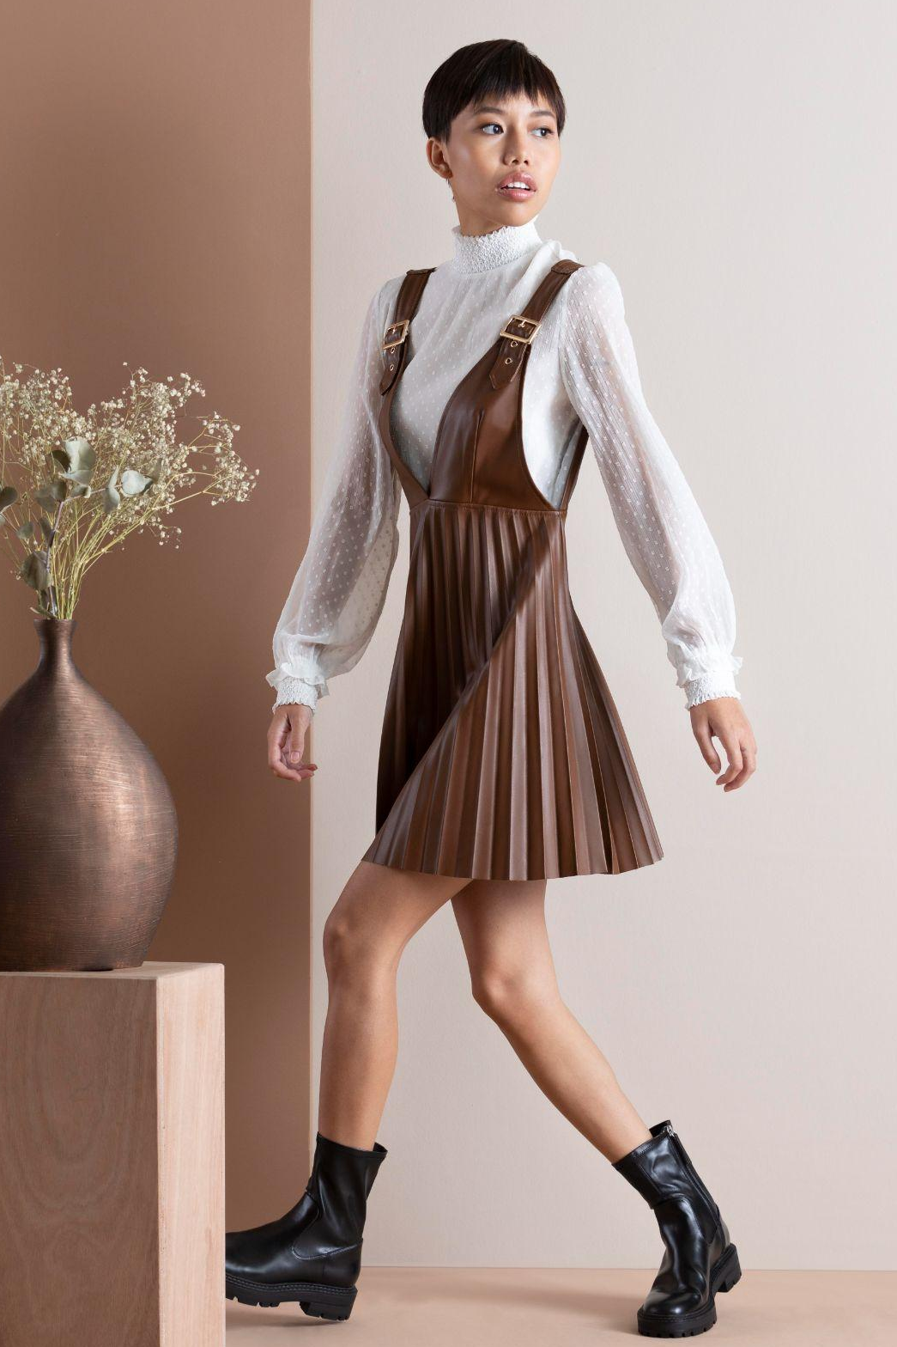
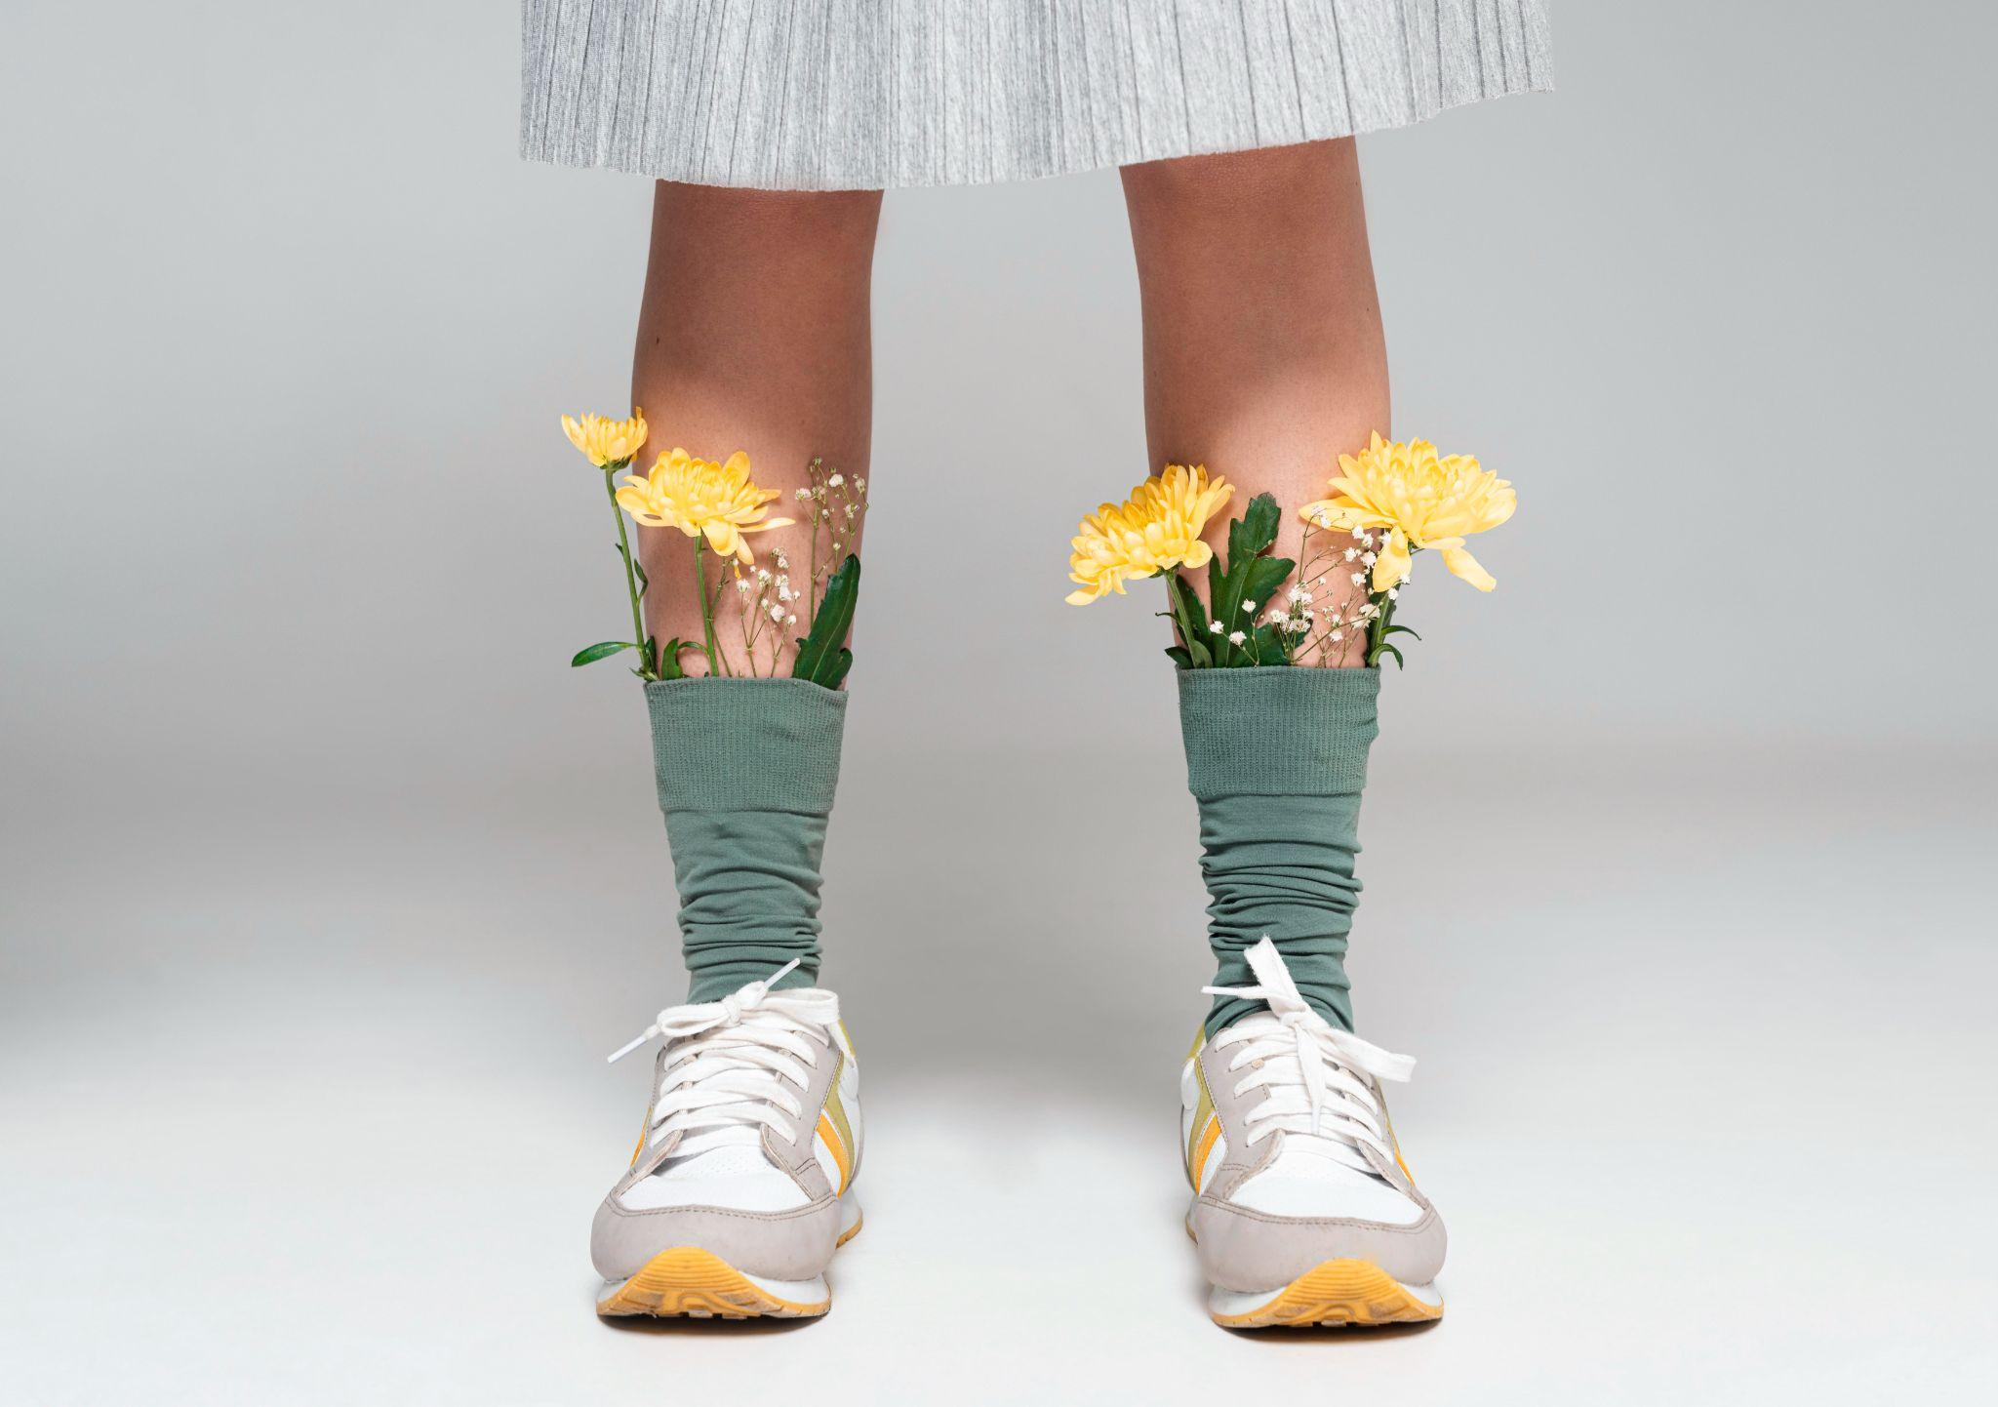
FASHION DESCRIPTION GENERATOR.
@modernclothing
Naomie Marciano
@modernclothing

Slide 2
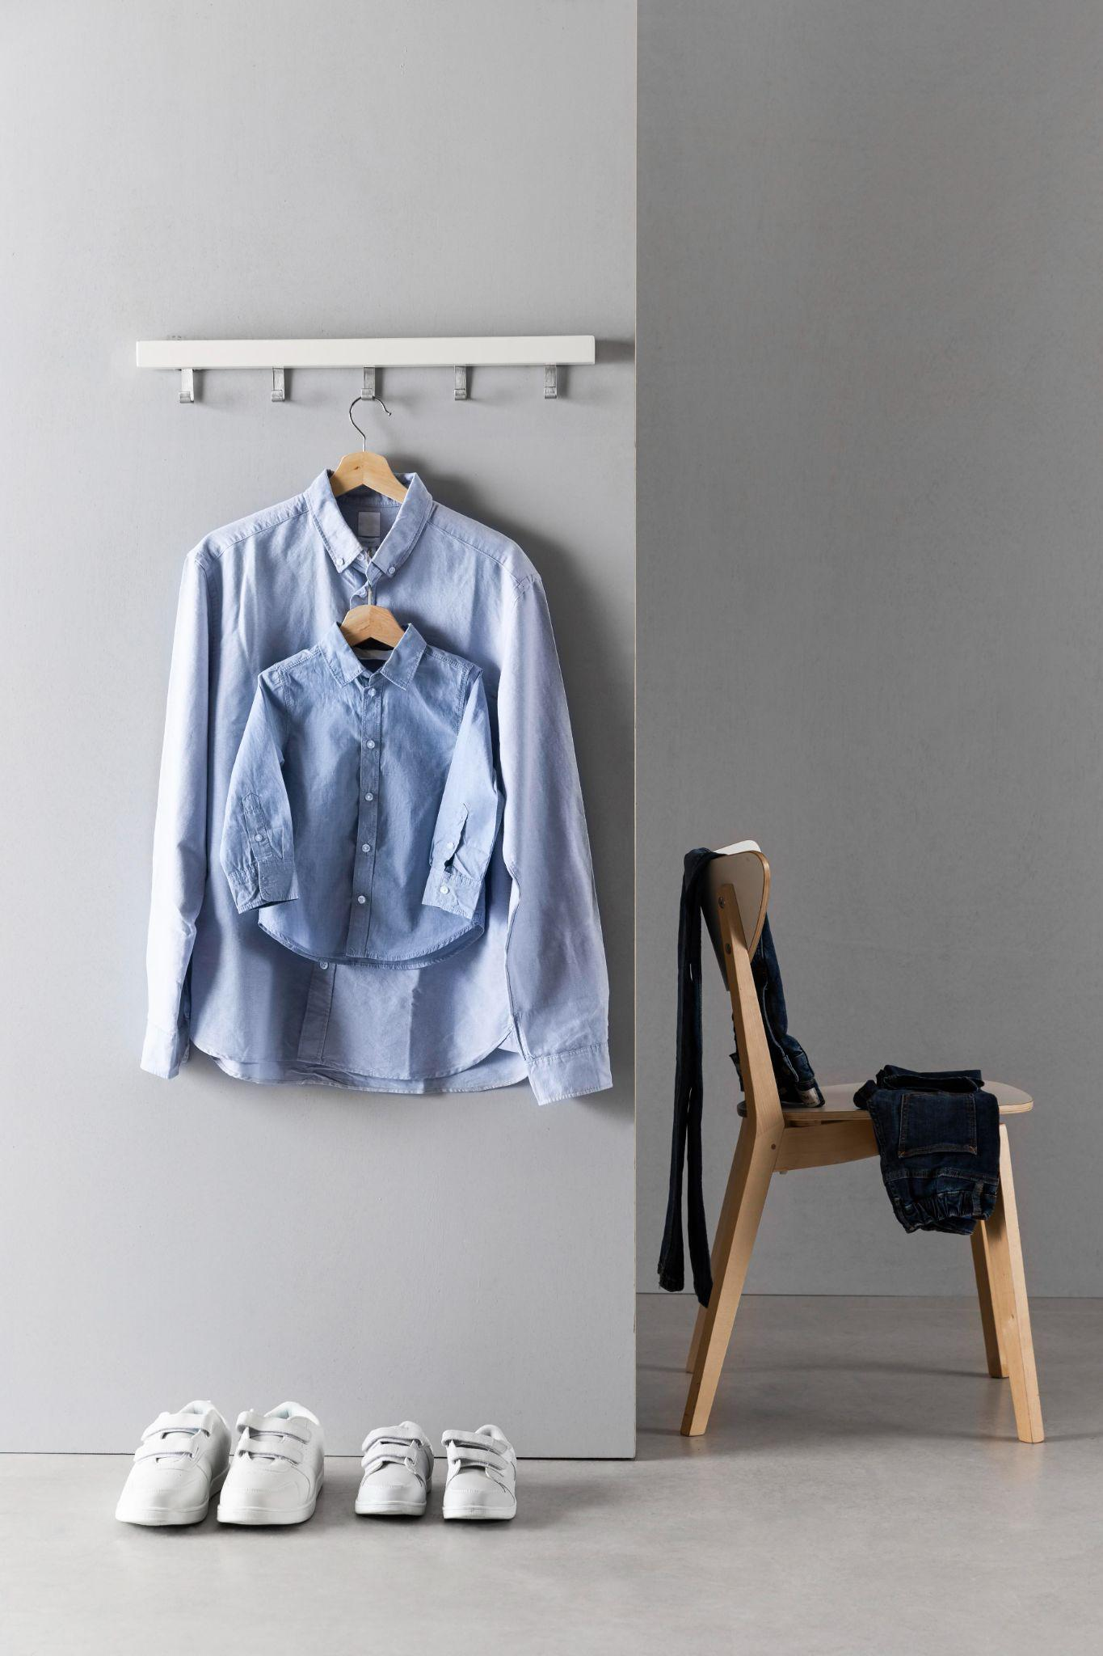
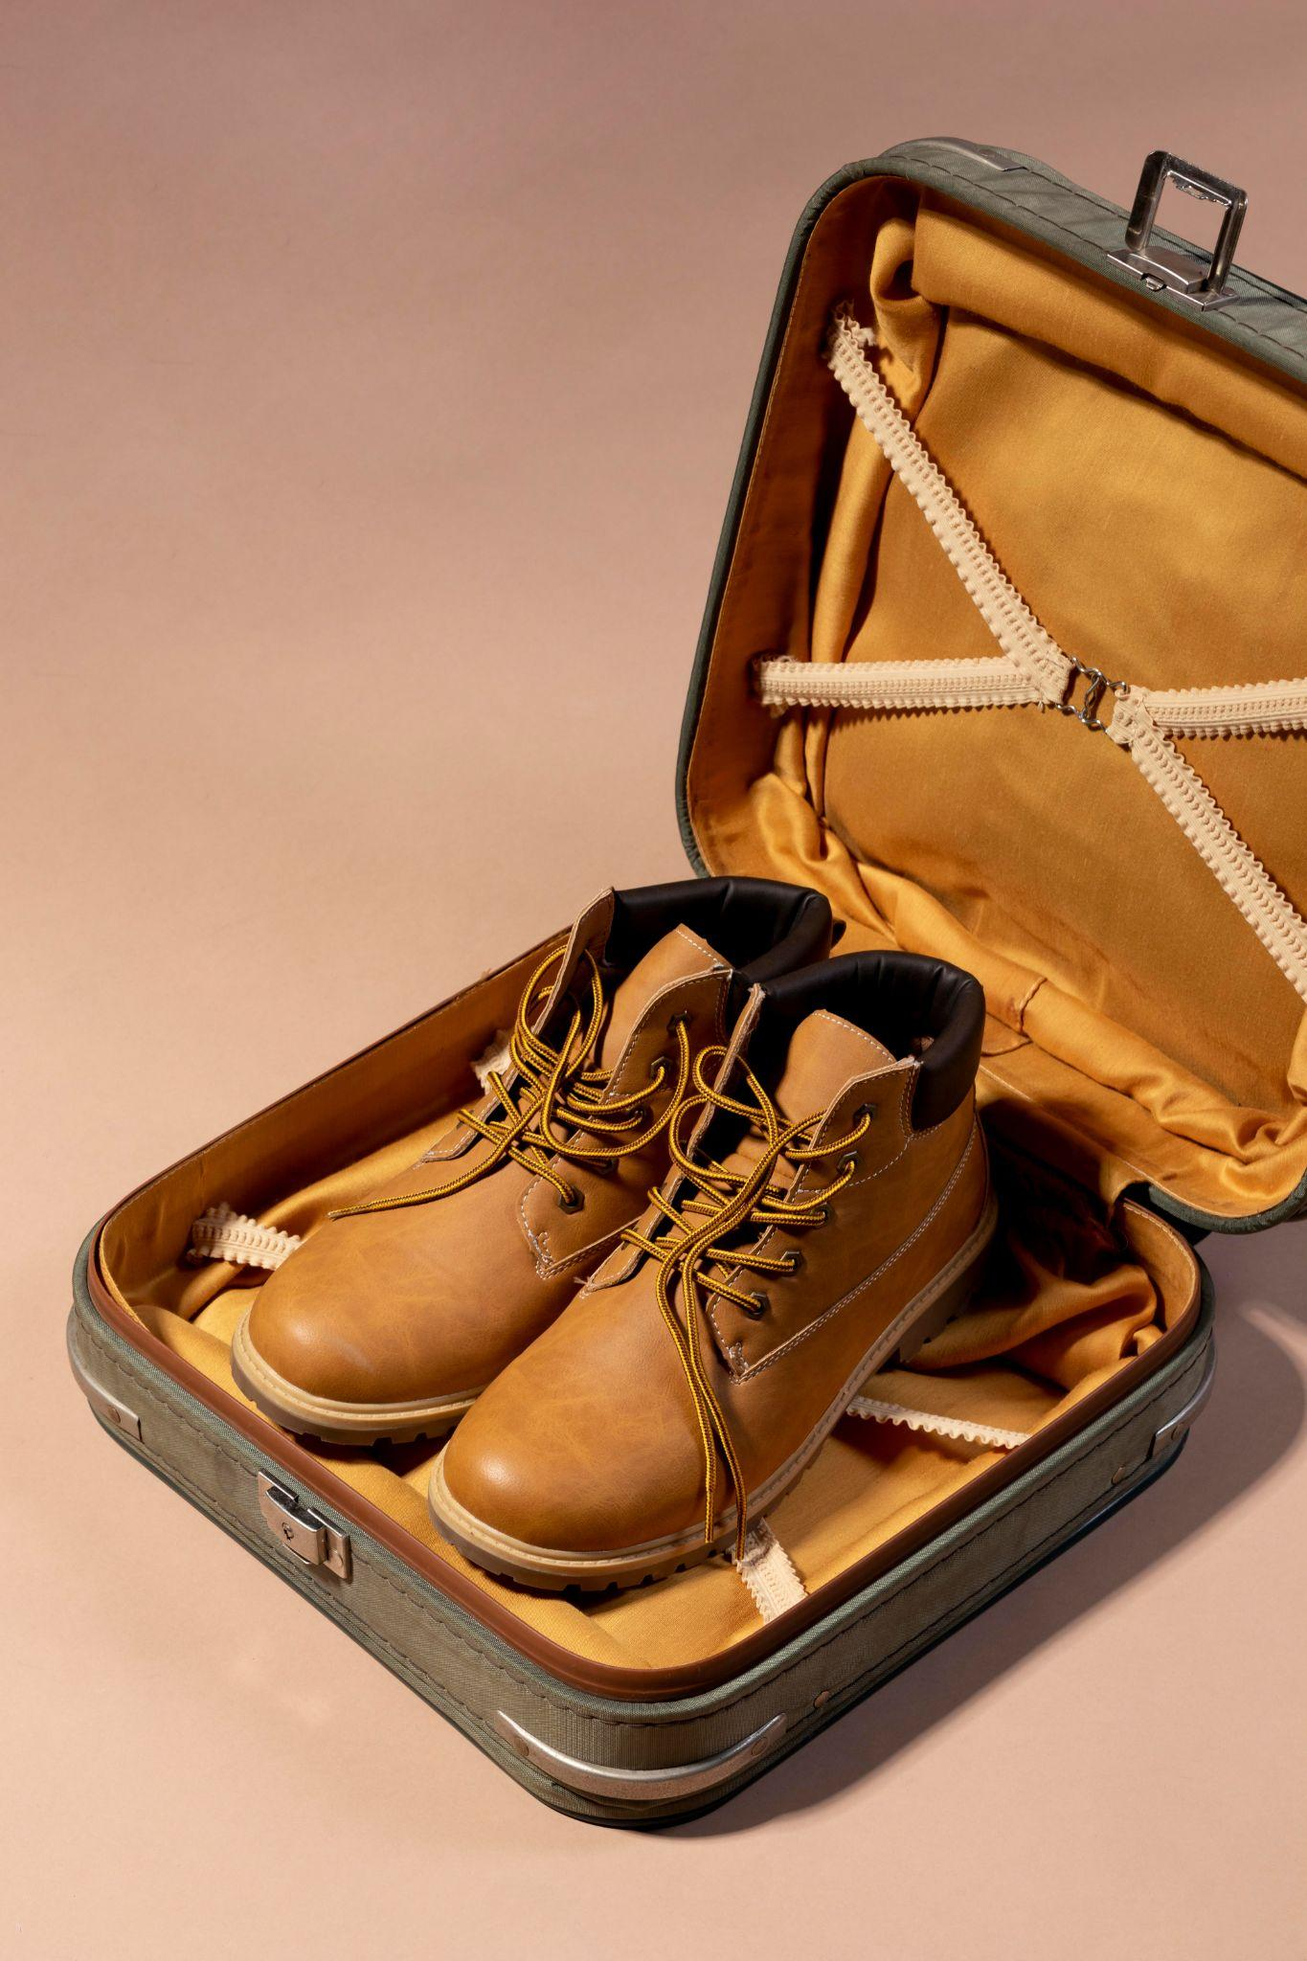
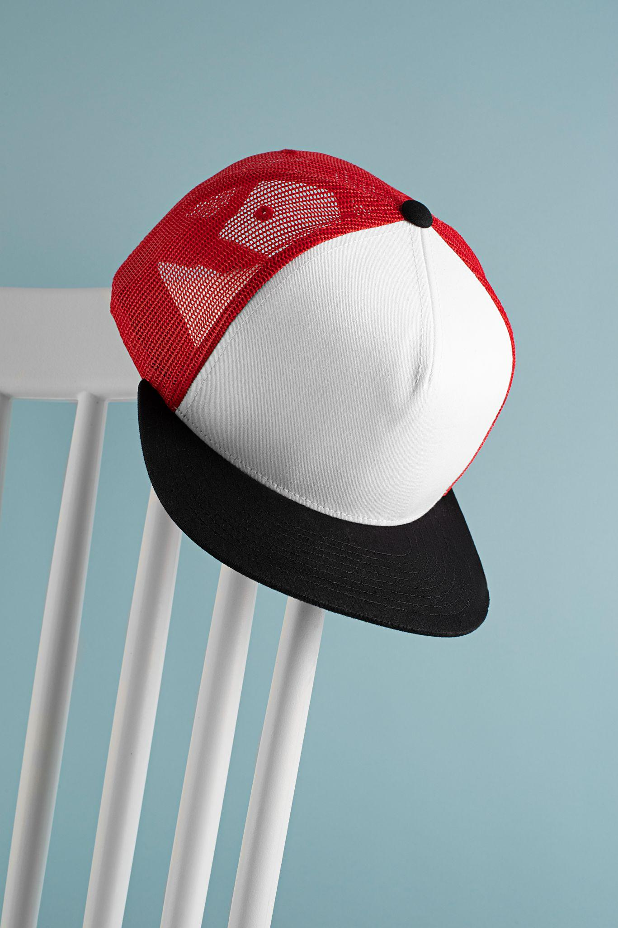
TABLE OF CONTENTS
01
02
03
04
STEPS
ABOUT THE PROJECT
WORKFLOW
OUTPUT

Slide 3
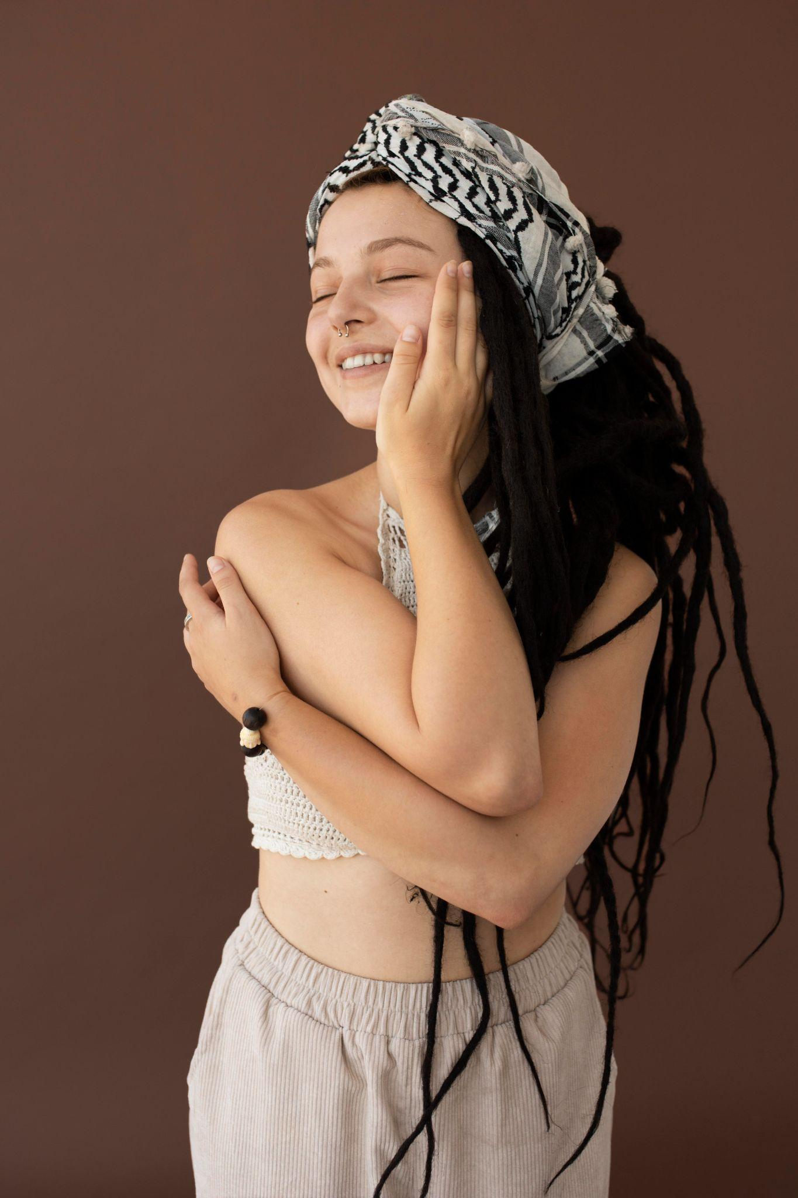
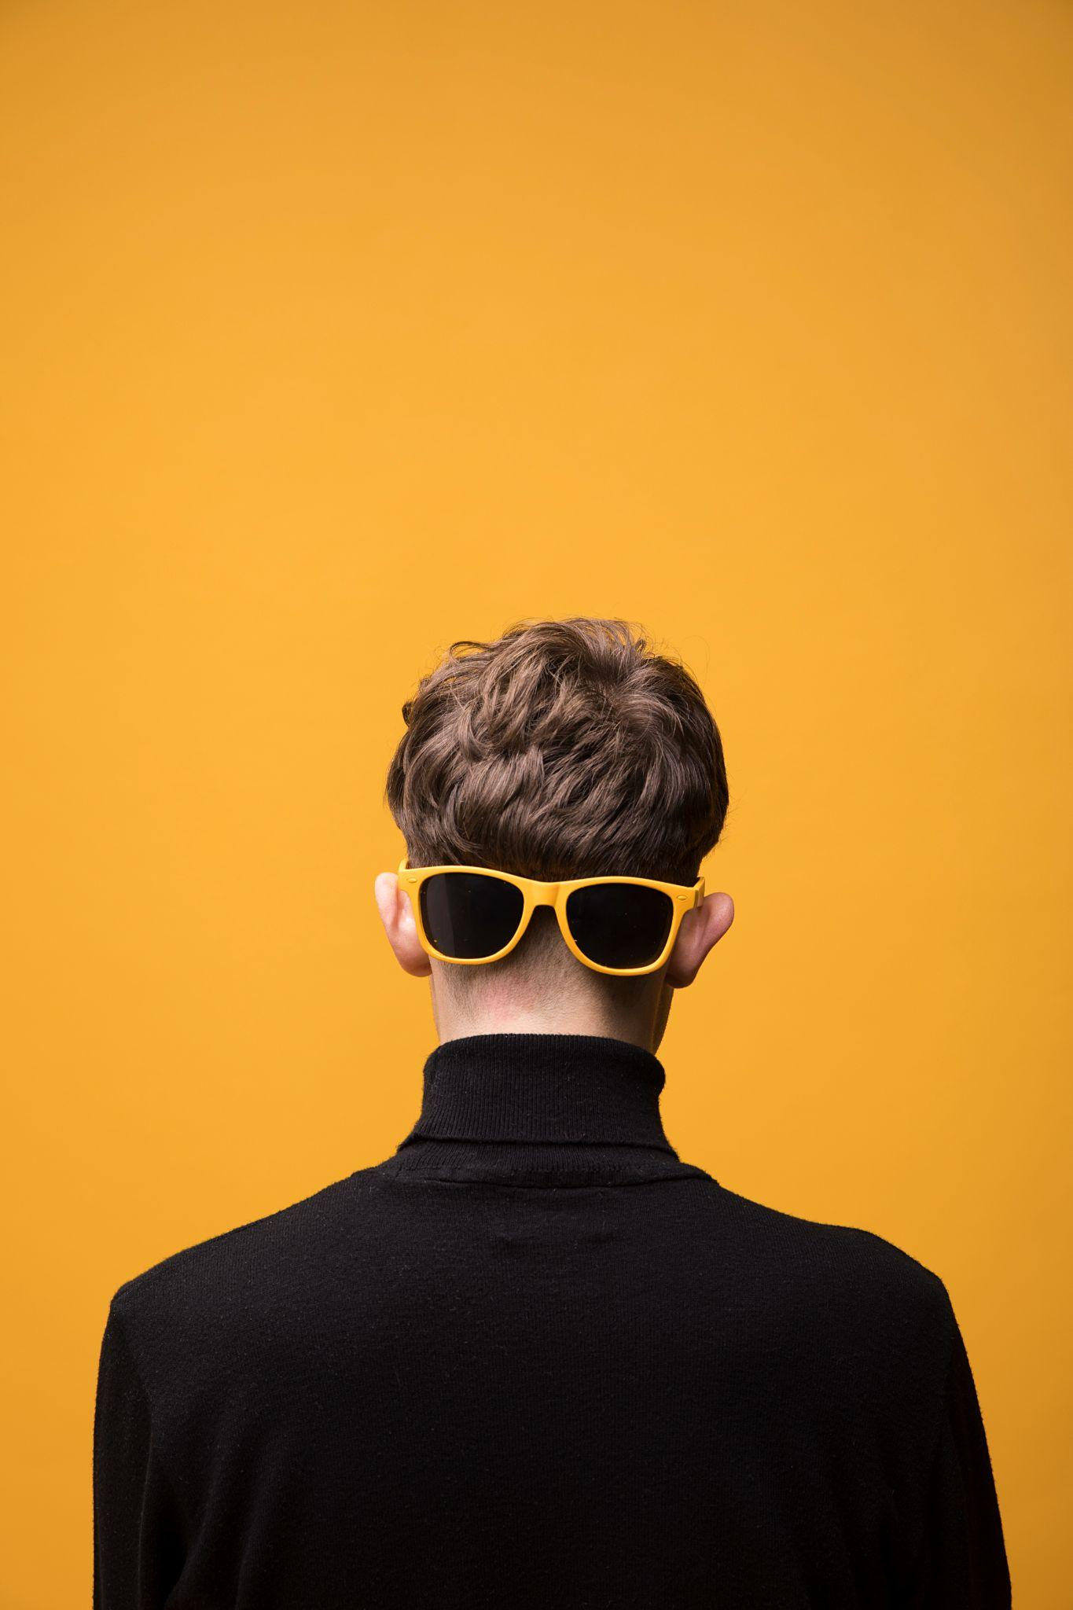
01
About The Project

Slide 4
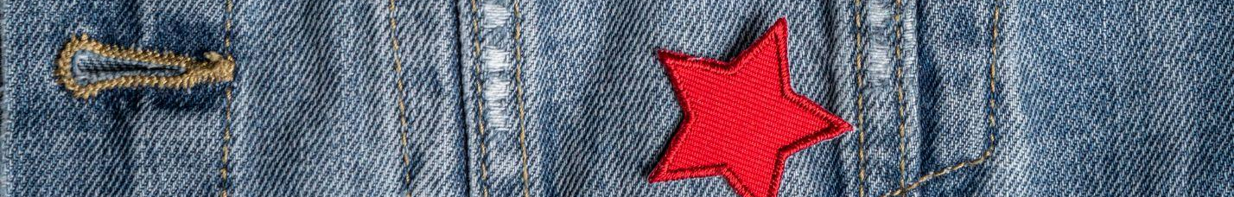
About The Project
Develop a lightweight, automated Generative AI pipeline that :
Creates high-quality fashion product descriptions from images or keywords
Runs efficiently on CPU-only machines (Suitable for lightweight deployments)
Ideal for fashion e-commerce and content creators seeking scalable, responsible content generation.

Slide 5
Input: Fashion item photo or descriptive term
Output: Polished, stylish, and ready-to-publish product description
Pipeline Components: 🔄 Input Handling (image or keyword interpretation) 🤖 Description Generation (using a lightweight model like DistilGPT-2) ✨ Content Review (via NLP tools such as spaCy or LanguageTool) 🛡️ Ethical Screening (custom blocklist for sensitive terms or stereotypes) ✅ Final Text Formatting

Slide 6
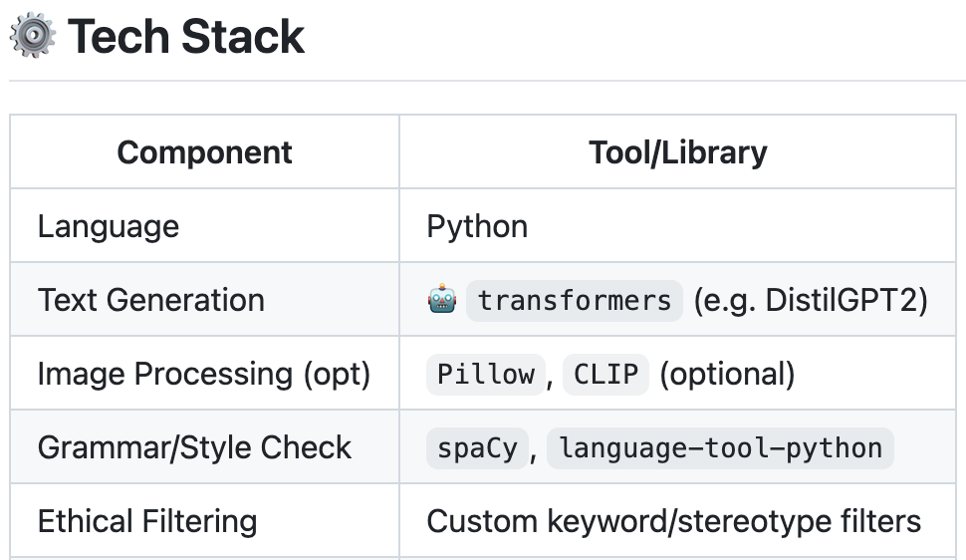
Technologies
Uses small, fast models (DistilGPT2)
No GPU dependency
Suitable for lightweight deployments (local machine, small server, edge device)
BART: understands text deeply and generates clear, natural summaries.

Slide 7
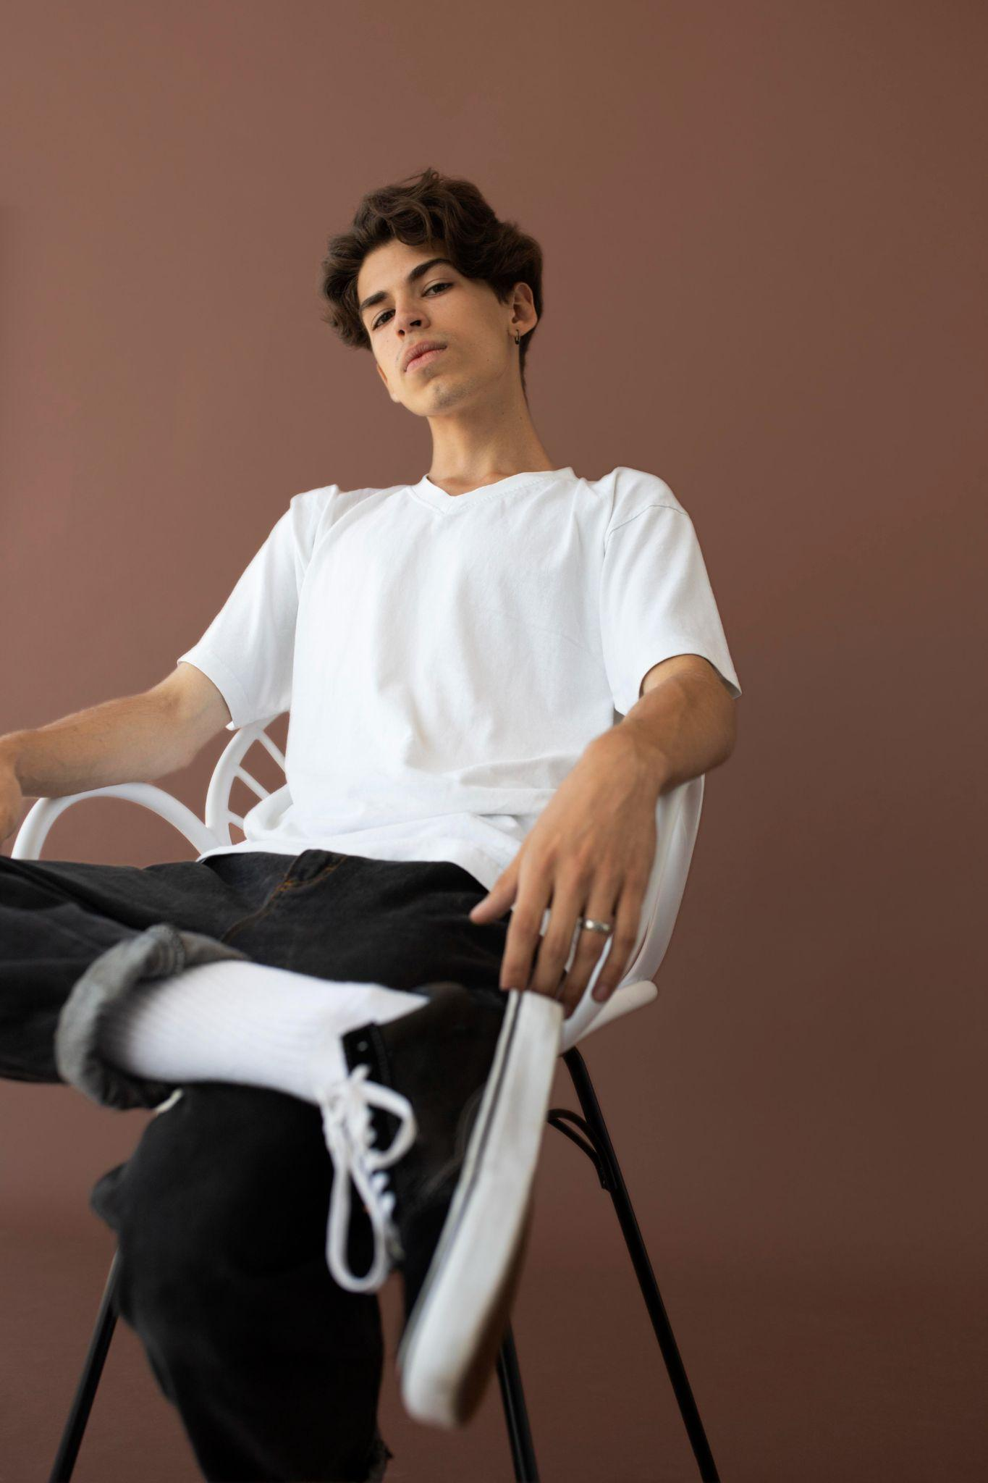
02
Workflow.
@modernclothing
You can enter a subtitle here if you need it
@modernclothing

Slide 8
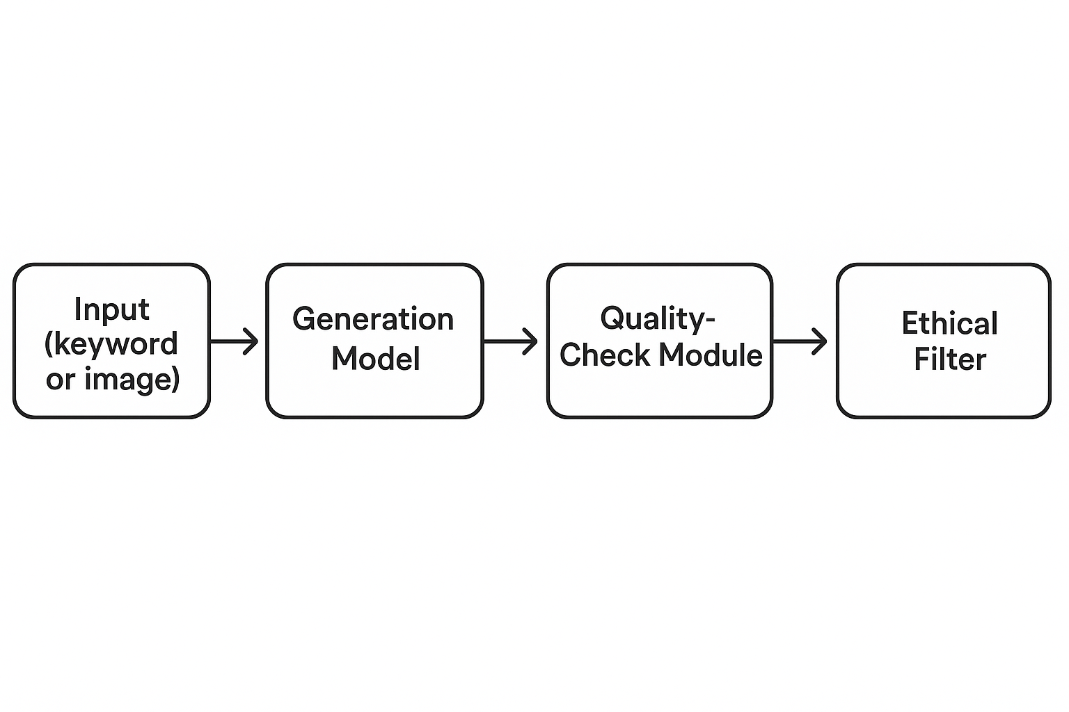
WORKFLOW

Slide 9

STEPS.
03

Slide 10
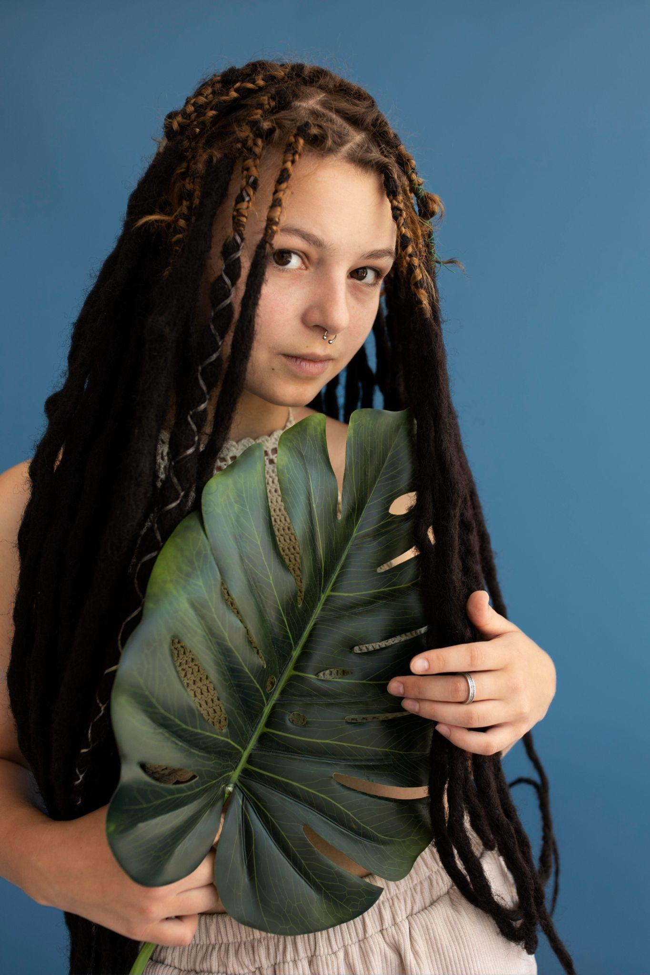

1. User Input: The user provides either a fashion keyword (e.g. “beige oversized blazer”) or an image of a clothing item.
2. Attribute Extraction: The system extracts key product attributes such as color, clothing type, and material (image-based detection is optional).
3. Generative Description Module: The extracted attributes are passed to a text generation model (e.g. DistilGPT2), which produces a first draft of the product description.
@modernclothing
@modernclothing

Slide 11
4. A quality checker runs:
Grammar/spelling analysis
Readability assessment
5. Ethical filter: The description is passed through an ethical filter
Detects and blocks stereotypes,sensitive language, or discriminatory terms
6 . Output: The final text is returned to the user, clean and market-ready

Slide 12
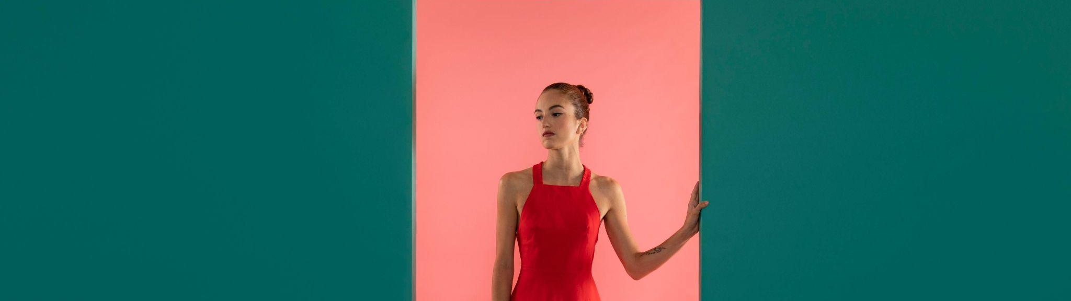
OUTPUT.
04
You can enter a subtitle here if you need it

Slide 13
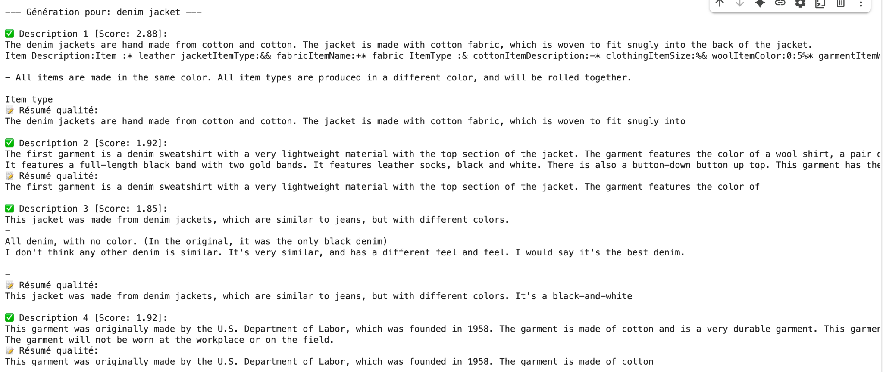

Slide 14
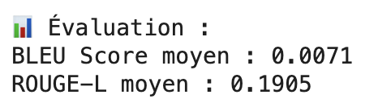
BLEU Score (0.0071): Very low overlap of exact word sequences between generated and reference texts, indicating poor match in wording and phrasing.
ROUGE-L Score (0.1905): Slightly better, showing some shared phrases or word order similarity, but overall still low similarity.
Interpretation: Generated descriptions differ substantially from the reference, suggesting room for improvement in generating more accurate or faithful text.

